Slide 1
DESIGN (ANTI-)PATTERNS
Coffee Break
Template Method

Slide 2
WHAT ARE DESIGN PATTERNS
A software design pattern is a general, reusable solution to a commonly occurring problem. It is not a finished design that can be transformed directly into source or machine code. It is a description or template for how to solve a problem that can be used in many different situations. Design patterns are formalized best practices that the programmer can use to solve common problems when designing an application or system.
Types
Creational (singleton, builder, lazy init, abstract factory, object pool etc.)
Structural (adapter, bridge, decorator, facade, composite, proxy etc.)
Behavioral (iterator, strategy, template method, visitor, command etc.)
Concurrency (thread pool, double checked locking, monitor object, reactor etc.)

Slide 3
TEMPLATE METHOD

Slide 4
TEMPLATE METHOD
The template method pattern is:
a behavioral design pattern
that defines the program skeleton of an algorithm in an operation, deferring some steps to subclasses
It lets one redefine certain steps of an algorithm without changing the algorithm's structure (maybe)

Slide 5
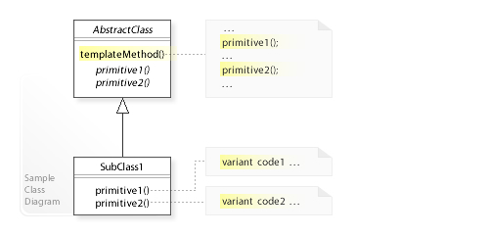
UML class diagram

Slide 6
TEMPLATE METHOD
This pattern has two main parts, and typically uses object-oriented programming
The "template method", generally implemented as a base class (possibly an abstract class), which contains shared code and parts of the overall algorithm which are invariant. The template ensures that the overarching algorithm is always followed.[1] In this class, "variant" portions are given a default implementation, or none at all.
Concrete implementations of the abstract class, which fill in the empty or "variant" parts of the "template" with specific algorithms that vary from implementation to implementation.[3]

Slide 7
TEMPLATE METHOD
Example

Slide 8
TEMPLATE METHOD
Operation variation:
Skeleton final methods
Abstract methods
Overridable methods
Variable number of operations (Iterator of Commands)
Do we allow to override the original algorithm? (JDK allows)

Slide 9
TEMPLATE METHOD
Questions and discussion

